Slide 1
Chapter 3
Input/Output

Slide 2
Objectives (1 of 2)
In this chapter, you will:
Learn what a stream is and examine input and output streams
Explore how to read data from the standard input device
Learn how to use predefined functions in a program
Explore how to use the input stream functions get, ignore, putback, and peek

Slide 3
Objectives (2 of 2)
Become familiar with input failure
Learn how to write data to the standard output device
Discover how to use manipulators in a program to format output
Learn how to perform input and output operations with the string data type
Learn how to debug logic errors
Become familiar with file input and output

Slide 4
Type Conversion (Casting) (1 of 2)
Implicit type coercion: when the value of one type is automatically changed to another type
Cast operator (also called type conversion or type casting): provides explicit type conversion
static_cast<dataTypeName>(expression)

Slide 5
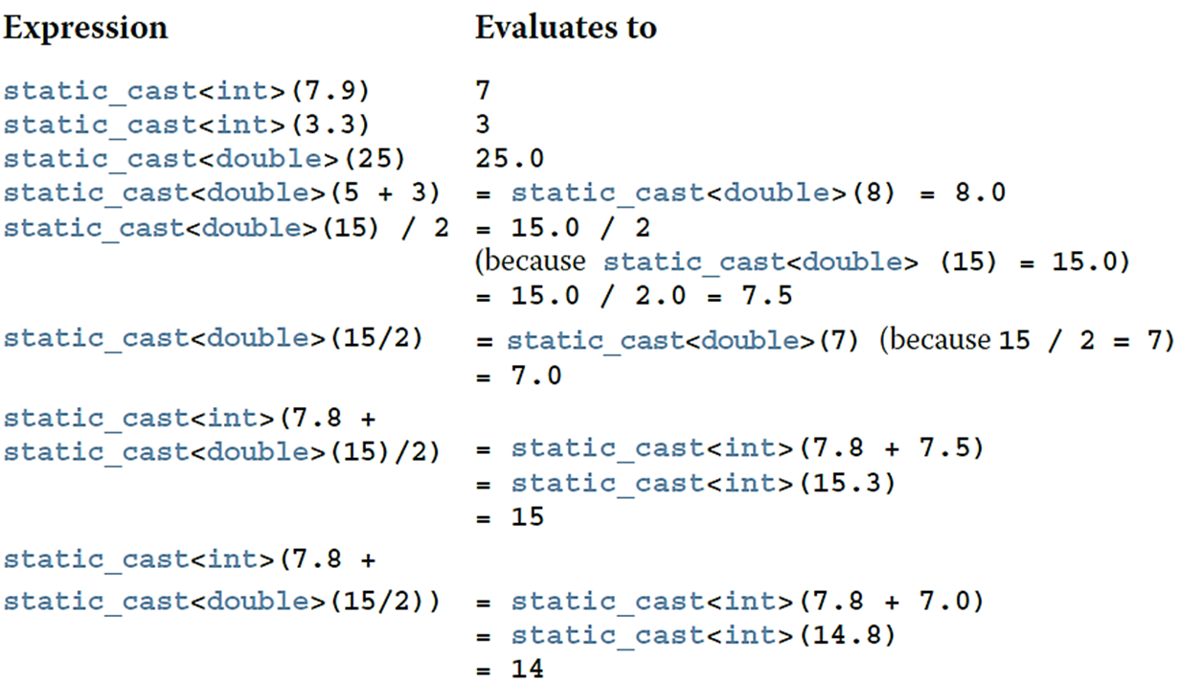
Type Conversion (Casting) (2 of 2)
EXAMPLE 2-9

Slide 6
I/O Streams and Standard I/O Devices (1 of 3)
I/O: sequence of bytes (stream of bytes) from source to destination
Bytes are usually characters, unless program requires other types of information
Stream: sequence of characters from the source to the destination
Input stream: sequence of characters from an input device to the computer
Output stream: sequence of characters from the computer to an output device

Slide 7
I/O Streams and Standard I/O Devices (2 of 3)
Use iostream header file to receive data from keyboard and send output to the screen
Contains definitions of two data types:
istream: input stream
ostream: output stream
Has two variables:
cin: stands for common input
cout: stands for common output

Slide 8
I/O Streams and Standard I/O Devices (3 of 3)
Variable declaration is similar to:
istream cin;
ostream cout;
To use cin and cout, the preprocessor directive #include <iostream> must be used
Input stream variables: type istream
Output stream variables: type ostream

Slide 9



cin and the Extraction Operator >> (1 of 7)
The syntax of an input statement using cin and the extraction operator
is
The extraction operator
is binary
Left-side operand is an input stream variable
Example: cin
Right-side operand is a variable

Slide 10
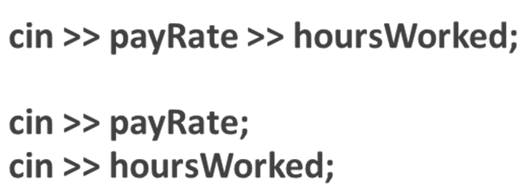



cin and the Extraction Operator >> (2 of 7)
No difference between a single cin with multiple variables and multiple cin statements with one variable in each statement
When scanning,
skips all whitespace
Blanks and certain nonprintable characters
distinguishes between character 2 and number 2 by the right-side operand
of
If type char or int (or double), the 2 is treated as a character or as a number 2, respectively

Slide 11
cin and the Extraction Operator >> (3 of 7)
TABLE 3-1 Valid Input for a Variable of the Simple Data Type
Data Type of a | Valid Input for a
char | One printable character except the blank.
int | An integer, possibly preceded by a + or - sign.
double | A decimal number, possibly preceded by a + or - sign. If the actual data input is an integer, the input is converted to a decimal number with the zero decimal part.
Entering a char value into an int or double variable causes serious errors, called input failure

Slide 12


cin and the Extraction Operator >> (4 of 7)
When reading data into a char variable
skips leading whitespace, finds and stores only the next character
Reading stops after a single character
To read data into an int or double variable
skips leading whitespace, reads + or - sign (if any), reads the digits (including
decimal for floating-point variables)
Reading stops on whitespace or a non-digit character

Slide 13
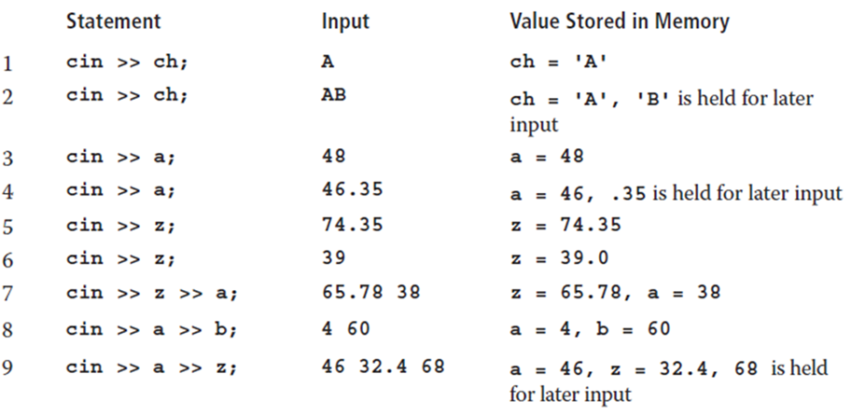
cin and the Extraction Operator >> (5 of 7)
EXAMPLE 3-1
Suppose you have the following variable declarations:
int a, b;
double z;
char ch;
The following statements show how the extraction operator >> works.

Slide 14
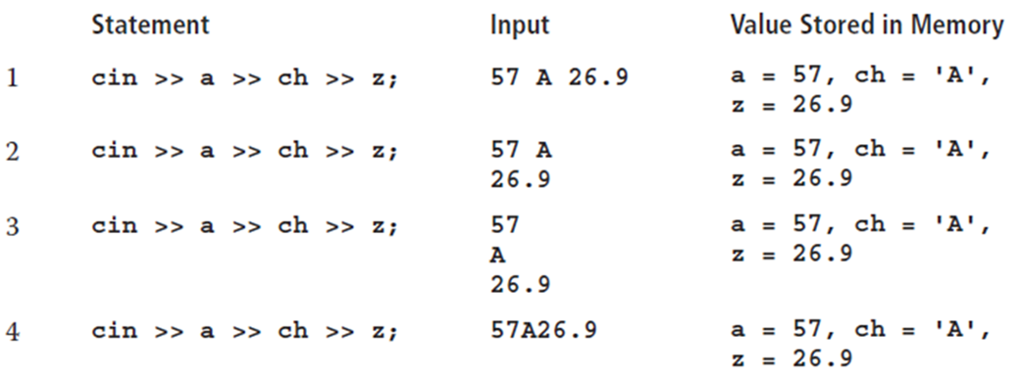
cin and the Extraction Operator >> (6 of 7)
EXAMPLE 3-2
Suppose you have the following variable declarations:
int a;
double z;
char ch;
The following statements show how the extraction operator >> works.

Slide 15
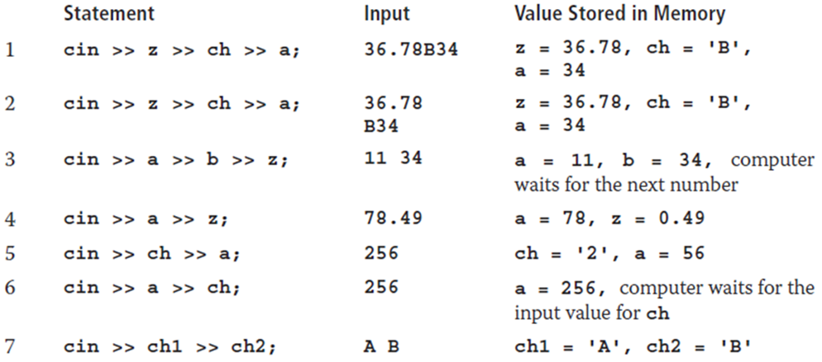
cin and the Extraction Operator >> (7 of 7)
EXAMPLE 3-3
Suppose you have the following variable declarations:
int a, b;
double z;
char ch, ch1, ch2;
The following statements show how the extraction operator >> works.

Slide 16
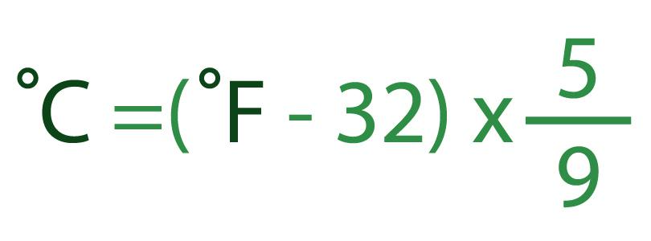
Ex 1.
Task: Fahrenheit to Celsius. The output is an integer!!!

Slide 17
Ex.2: Casting with User Input
Write a program that asks the user for an integer input. The program should then convert this integer to a float and multiply it by 3.14159 (a representation of π). Finally, the result should be displayed to the user.

Slide 18
Using Predefined Functions in a Program (1 of 3)
A function (subprogram) is a set of instructions
When activated, it accomplishes a task
main executes when a program is run
Other functions execute only when called
C++ includes a wealth of functions
Predefined functions are organized as a collection of libraries called header files

Slide 19
Using Predefined Functions in a Program (2 of 3)
Header file may contain several functions
To use a predefined function, you need the name of the appropriate header file
You also need to know:
Function name
Number of parameters required
Type of each parameter
What the function is going to do

Slide 20

Using Predefined Functions in a Program (3 of 3)
To use pow (power), include cmath
Two numeric parameters
Syntax:
x and y are the arguments or parameters
In pow(2,3), the parameters are 2 and 3

Slide 21
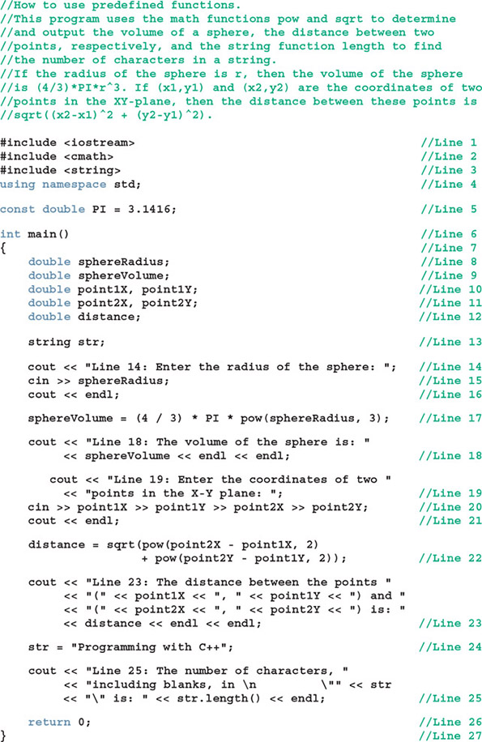
Ex. 3: Calculation

Slide 22
Practice Problem:
Write a program that calculates the following using the pow function:
The result of 5 raised to the power of 4.
The result of 7 raised to the power of 2.
The result of 10 raised to the power of 3.
Expected Output:
For 5 raised to the power of 4, the output should be 625.
For 7 raised to the power of 2, the output should be 49.
For 10 raised to the power of 3, the output should be 1000.
Calculate the result of a negative base with an exponent, for example, pow(-2, 3).

Slide 23

cin and the get Function
The get function
Inputs next character (including whitespace)
Stores in memory location indicated by its argument
The syntax of cin and the get function
varChar is a char variable
It is the argument (or parameter) of the function

Slide 24
// C++ program to demonstrate cin.get()
#include <iostream>
using namespace std;
int main()
{
char name[25];
cin.get(name, 25);
cout << name;
return 0;
}

Slide 25
What will it happen when we change the second 25 to 3

Slide 26

cin and the ignore Function (1 of 2)
ignore function
Discards a portion of the input
The syntax to use the function ignore is:
intExp is an integer expression
chExp is a char expression
If intExp is a value m, the statement says to ignore the next m characters or all characters until the character specified by chExp

Slide 27
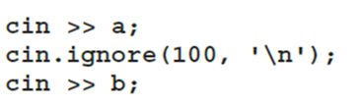



cin and the ignore Function (2 of 2)
EXAMPLE 3-5
Consider the declaration:
int a, b;
and the input:
25 67 89 43 72
12 78 34
Now consider the following statements:
The first statement,
stores 25 in a. The second statement,
discards all of the remaining numbers in the first line.
The third statement,
stores 12 (from the next line) in b.

Slide 28
The putback and peek Functions (1 of 2)
putback function
Places previous character extracted by the get function from an input stream back to that stream
peek function
Returns next character from the input stream
Does not remove the character from that stream

Slide 29


The putback and peek Functions (2 of 2)
Syntax for putback
istreamVar: an input stream variable (such as cin)
ch is a char variable
Syntax for peek
istreamVar: an input stream variable (such as cin)
ch is a char variable

Slide 30
Ex: Simple Arithmetic Parser
Create a program that reads characters from the input to perform simple arithmetic operations on two integers. The program should:
Ask the user to enter an arithmetic expression with two integers and an operator (+, -, *, or /), e.g., 5 + 3.
Use putback() to reinsert the operator into the stream after identifying it.
Perform the identified operation and display the result.

Slide 31
Ex:
Simulating a smart lock that allows users to enter a mix of random characters and the real password. The program will use cin.ignore() to ignore random input, focusing only on the real password embedded within the input stream.
Problem Setup:
The user can input long random characters with the real password embedded somewhere in between.
The real password will be a 6-digit numeric code.
The system will ignore all input except for the 6-digit password.
The lock will only allow the user to input a maximum of 5 random characters before the password is entered.
After detecting the 6-digit password, the program will ignore the rest of the input and validate the password.

Slide 32
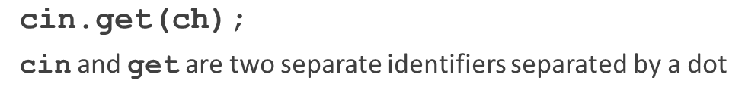
The Dot Notation between I/O Stream Variables and I/O Functions: A Precaution
In the statement
Called the dot notation, the dot separates the input stream variable name from the member, or function, name
In C++, the dot is the member access operator

Slide 33
Input Failure
Things can go wrong during execution
If input data does not match corresponding variables, the program may run into problems
Trying to read a letter into an int or double variable will result in an input failure
If an error occurs when reading data
Input stream enters the fail state

Slide 34

The clear Function
Once in a fail state, all further I/O statements using that stream are ignored
The program continues to execute with whatever values are stored in variables
This causes incorrect results
The clear function restores the input stream to a working state
The syntax of the function clear is:

Slide 35
Example: Handling Invalid Input
Problem Statement:
Write a program that asks the user to enter an integer. If the user enters an invalid input (e.g., a letter), the program should display an error message and prompt the user again until a valid integer is entered.

Slide 36

Output and Formatting Output
Syntax of cout when used with
expression is evaluated
value is printed
manipulator is used to format the output
Example: endl

Slide 37

setprecision Manipulator
Syntax
Outputs decimal numbers with up to n decimal places
Must include the header file iomanip
#include <iomanip>

Slide 38


fixed Manipulator
fixed outputs floating-point numbers in a fixed decimal format
Example:
Disable by using the stream member function unsetf
Example:
scientific manipulator outputs floating-point numbers in scientific format

Slide 39
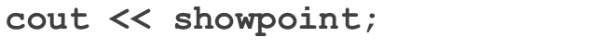

showpoint Manipulator
showpoint forces output to show the decimal point and trailing zeros
Examples

Slide 40
C++14 Digit Separator
Reading and writing of long numbers can be error prone
In C++, commas cannot be used to separate the digits of a number
C++14 introduces digit separator ' (single-quote character)
Example: 87523872918 can be represented as 87'523'872'918

Slide 41
setw
Outputs the value of an expression in a specified number of columns
If number of columns exceeds the number of columns required by the expression
Output of the expression is right-justified
Unused columns to the left are filled with spaces
Must include the header file iomanip

Slide 42
Additional Output Formatting Tools
Additional formatting tools that give you more control over your output:
setfill manipulator
left and right manipulators
unsetf manipulator

Slide 43

setfill Manipulator
Output stream variables can use setfill to fill unused columns with a character
Example:

Slide 44



left and right Manipulators
left manipulator left-justifies the output
Disable left by using unsetf
right manipulator right-justifies the output

Slide 45
Types of Manipulators
Two types of manipulators
Those with parameters
Those without parameters
Parameterized stream manipulators require the iomanip header
setprecision, setw, and setfill
Manipulators without parameters require the iostream header
endl, fixed, scientific, showpoint, and left

Slide 46
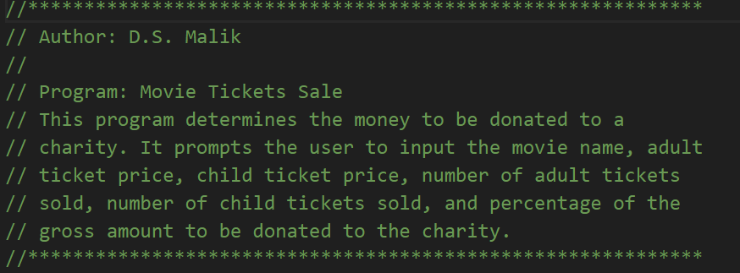
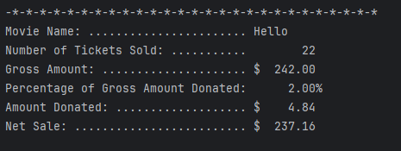
Example: Formatted output

Slide 47
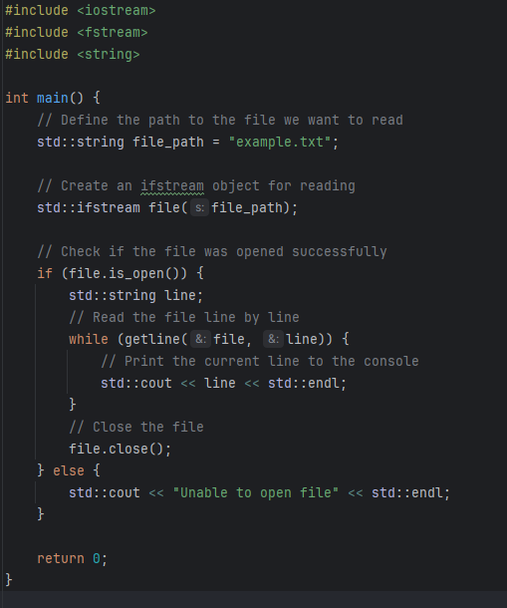
Read info from file

Slide 48
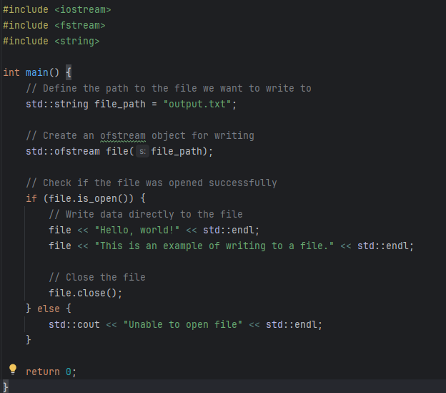
Write info to the file

Slide 49
Practice Problem:
Write a C++ program that displays a list of products with their prices. Use setw to align the output, setprecision to format the prices to two decimal places, and unsetf to reset any special formatting.
Task:
Display a list of 3 products with their prices.
Use setw to ensure the product names are aligned in one column and the prices in another.
Use setprecision to ensure the prices show exactly two decimal places.
After displaying the list, use unsetf to reset the formatting and display a message without any special formatting.

Slide 50

Input/Output and the string Type
An input stream variable (such as cin) and
operator can read a string into
a variable of the data type string
The extraction operator:
Skips any leading whitespace characters
Stops reading at a whitespace character
The function getline reads until end of the current line

Slide 51
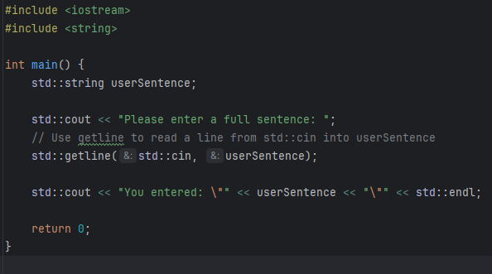
Example: Reading and Echoing a Full Sentence (using getline)
Problem Statement:
Create a program that prompts the user to enter a full sentence. Then, the program should print this sentence back to the user.

Slide 52
Debugging: Understanding Logic Errors and Debugging with cout statements
Syntax errors are reported by the compiler
Logic errors are typically not caught by the compiler
Spot and correct using cout statements
Temporarily insert an output statement
Correct the problem
Remove output statement

Slide 53

File Input/Output
A file is an area in secondary storage to hold info
File I/O is a five-step process
Include fstream header
Declare file stream variables
Associate the file stream variables with the input/output sources – referred to as opening the files
Use the file stream variables with
or other input/output functions
Close the files

Slide 54
Quick Review (1 of 3)
Stream: infinite sequence of characters from a source to a destination
Input stream: from a source to a computer
Output stream: from a computer to a destination
cin: common input
cout: common output
To use cin and cout, include iostream header

Slide 55
Quick Review (2 of 3)
get reads data character-by-character
ignore skips data in a line
putback puts last character retrieved by get back to the input stream
peek returns next character from input stream, but does not remove it
Attempting to read invalid data into a variable causes the input stream to enter the fail state

Slide 56
Quick Review (3 of 3)
The manipulators setprecision, fixed, showpoint, setw, setfill, left, and right can be used for formatting output
Include iomanip for the manipulators setprecision, setw, and setfill
Header fstream contains the definitions of ifstream and ofstream

